Slide 1
Learning to See in the Dark
Paper Presentation Vidhey Oza April 22, 2021

Slide 2
Agenda
01. Introduction
02. Data Exploration
03. Implementation
04. Results
05. Conclusion & Future Work

Slide 3
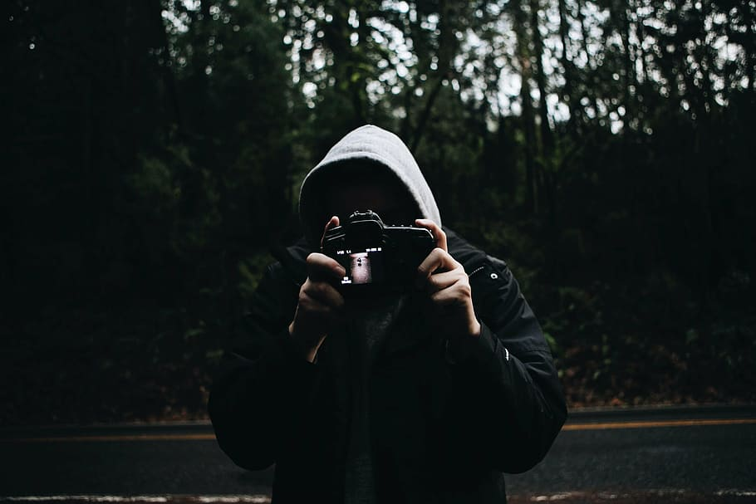
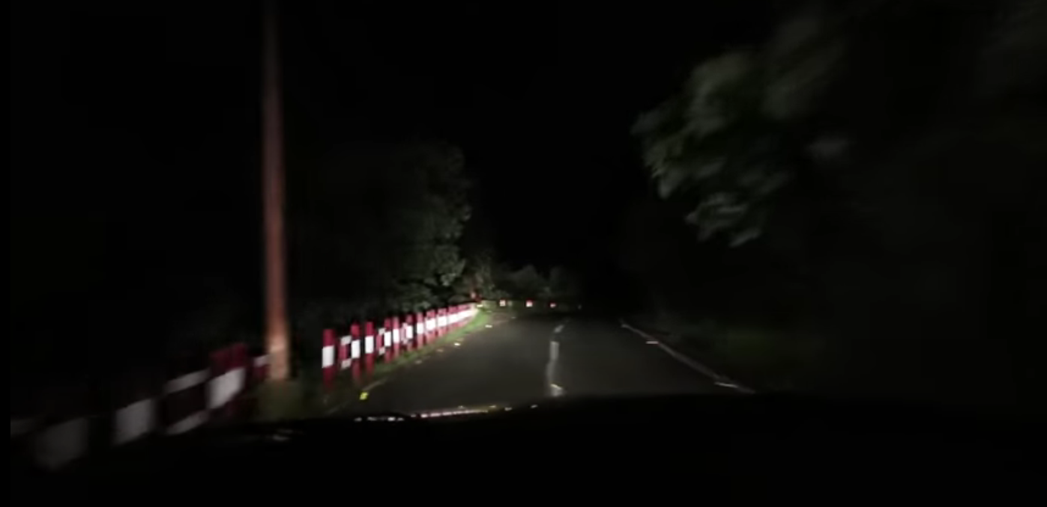
Introduction
Capturing low-light imagery difficult for daily-use devices (smartphones, GoPro, …)
Multi-exposure techniques prone to shaking, bad processing
AI-based techniques require high-quality datasets and light model footprint
Fully convolutional generative models show strong potential
Cameraman capturing in dark forest
Low visibility on road cams at night

Slide 4
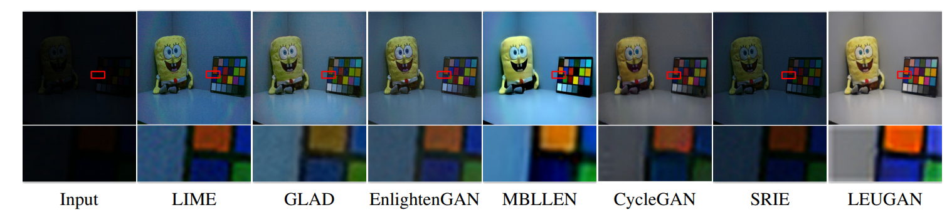
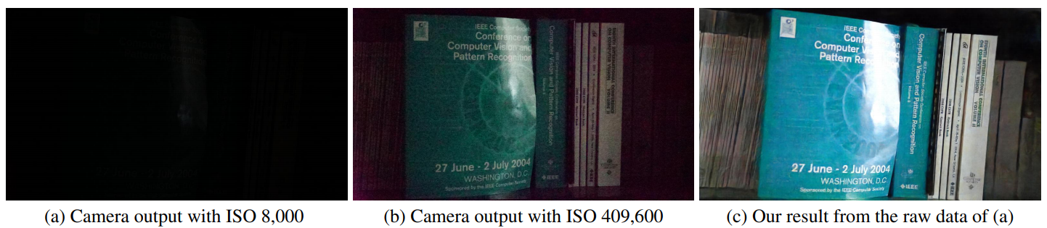
Problem Definition
Given a low-light image, enhance it by dynamically adding light in the scene
Supervised training implies dark-bright image pairs; difficult to find comprehensive dataset
GAN-based training can take dark image input, produce illuminated version that can fool discriminator from “real” bright image
Inspired by CVPR 2018 paper with same name

Slide 5
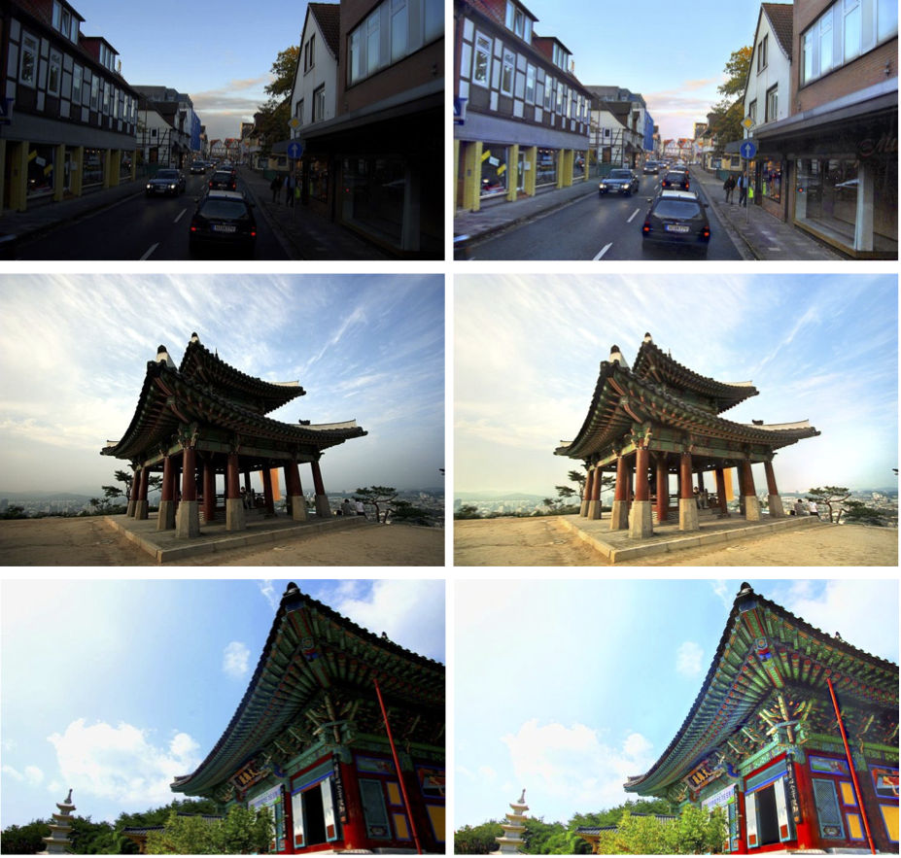
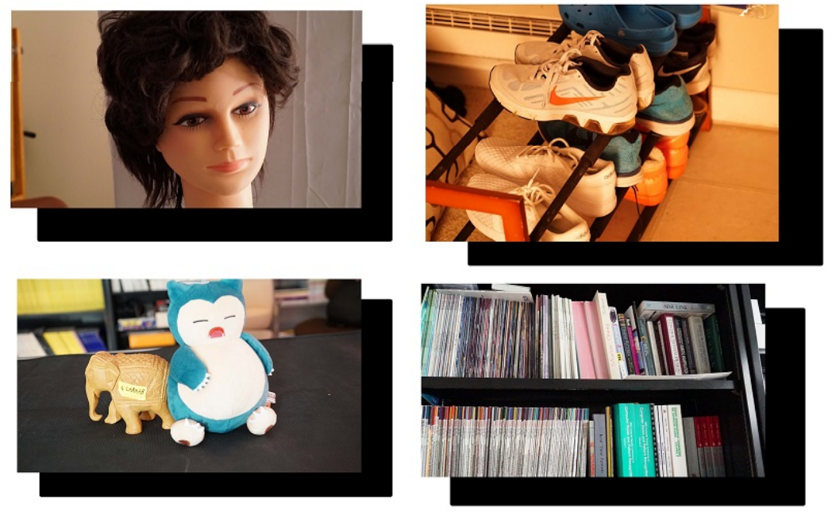
Data Exploration

Slide 6
Finding the right dataset
Datasets used by common methods
Problem
Custom-made datasets, bespoke for proposed algorithms
Singleton images generally – no bright counterpart for supervised training
Imbalance in indoors vs outdoors samples
Non-standardized capturing – significant variation in exposure, ISO etc.
Variety in image types missing – resort to combined datasets (for e.g., EnlightenGAN)

Slide 7
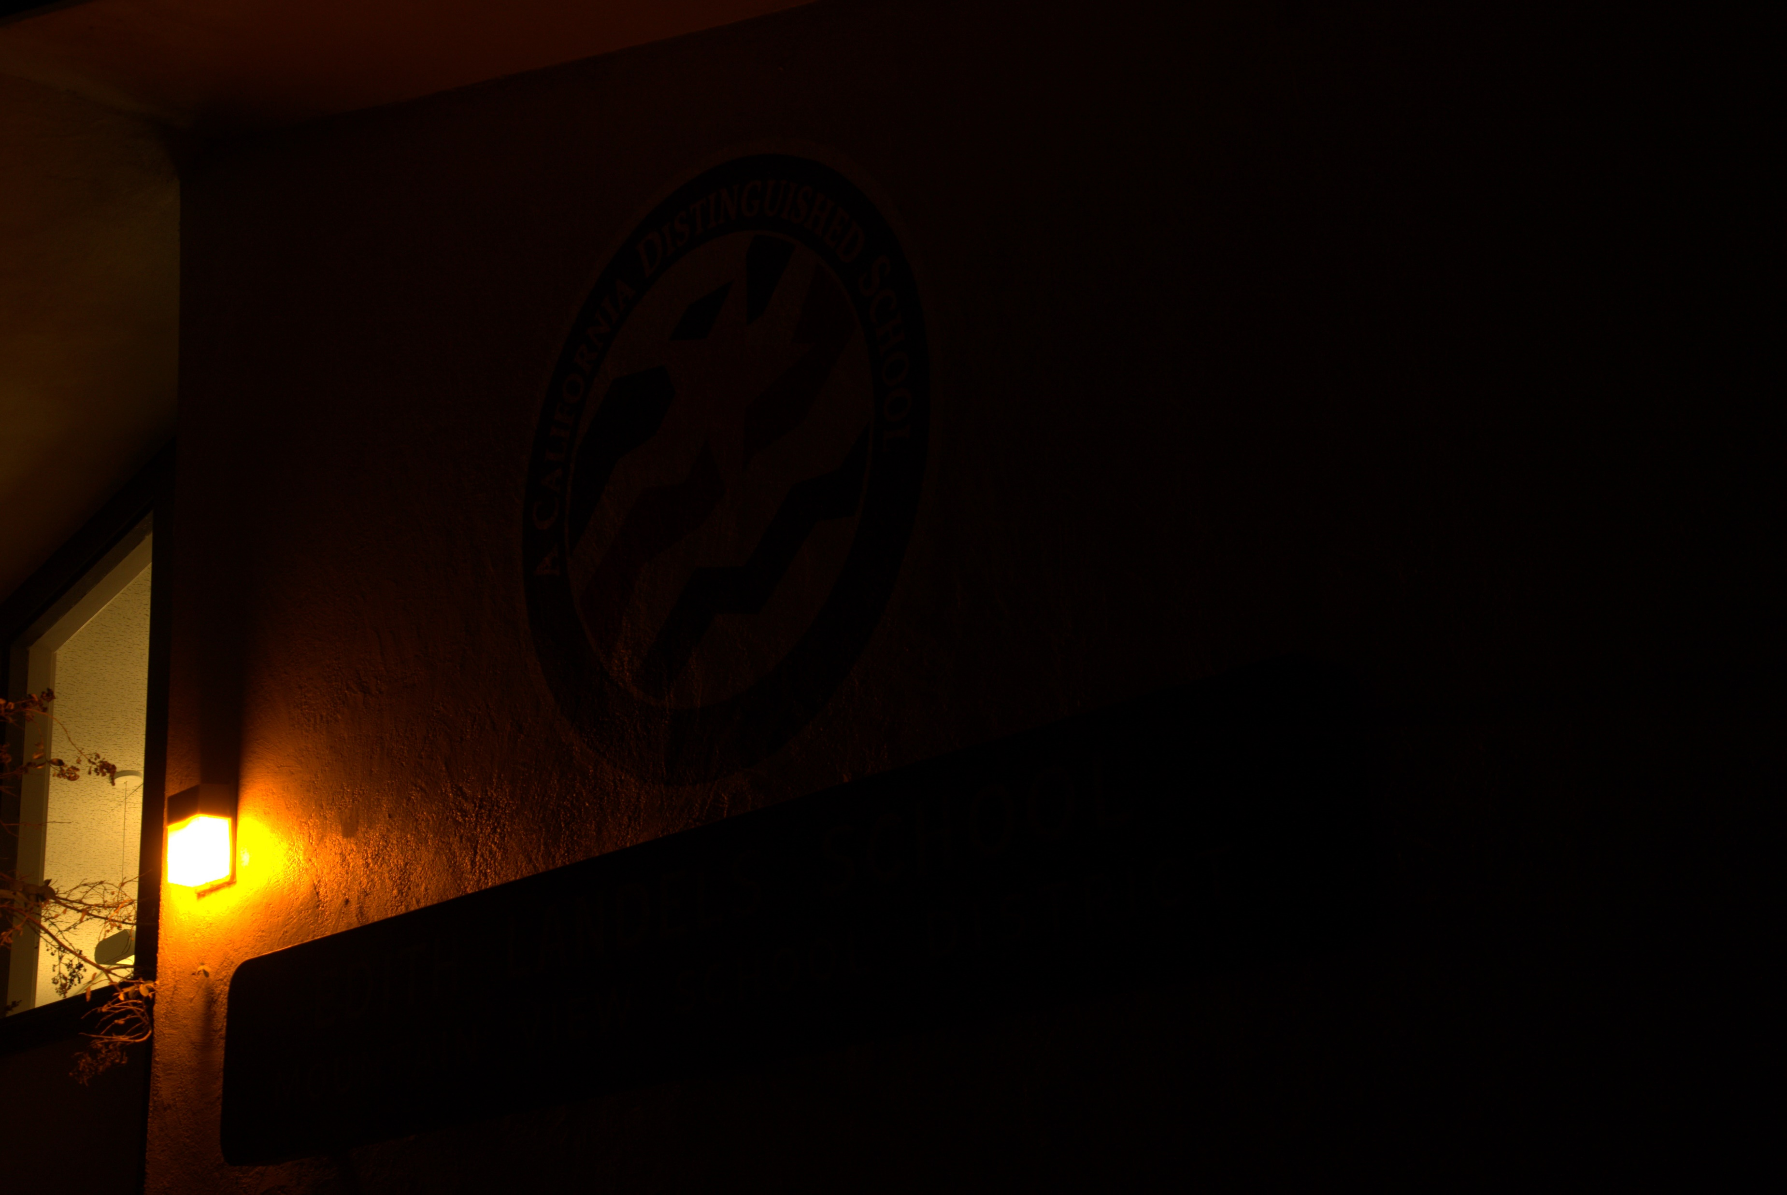
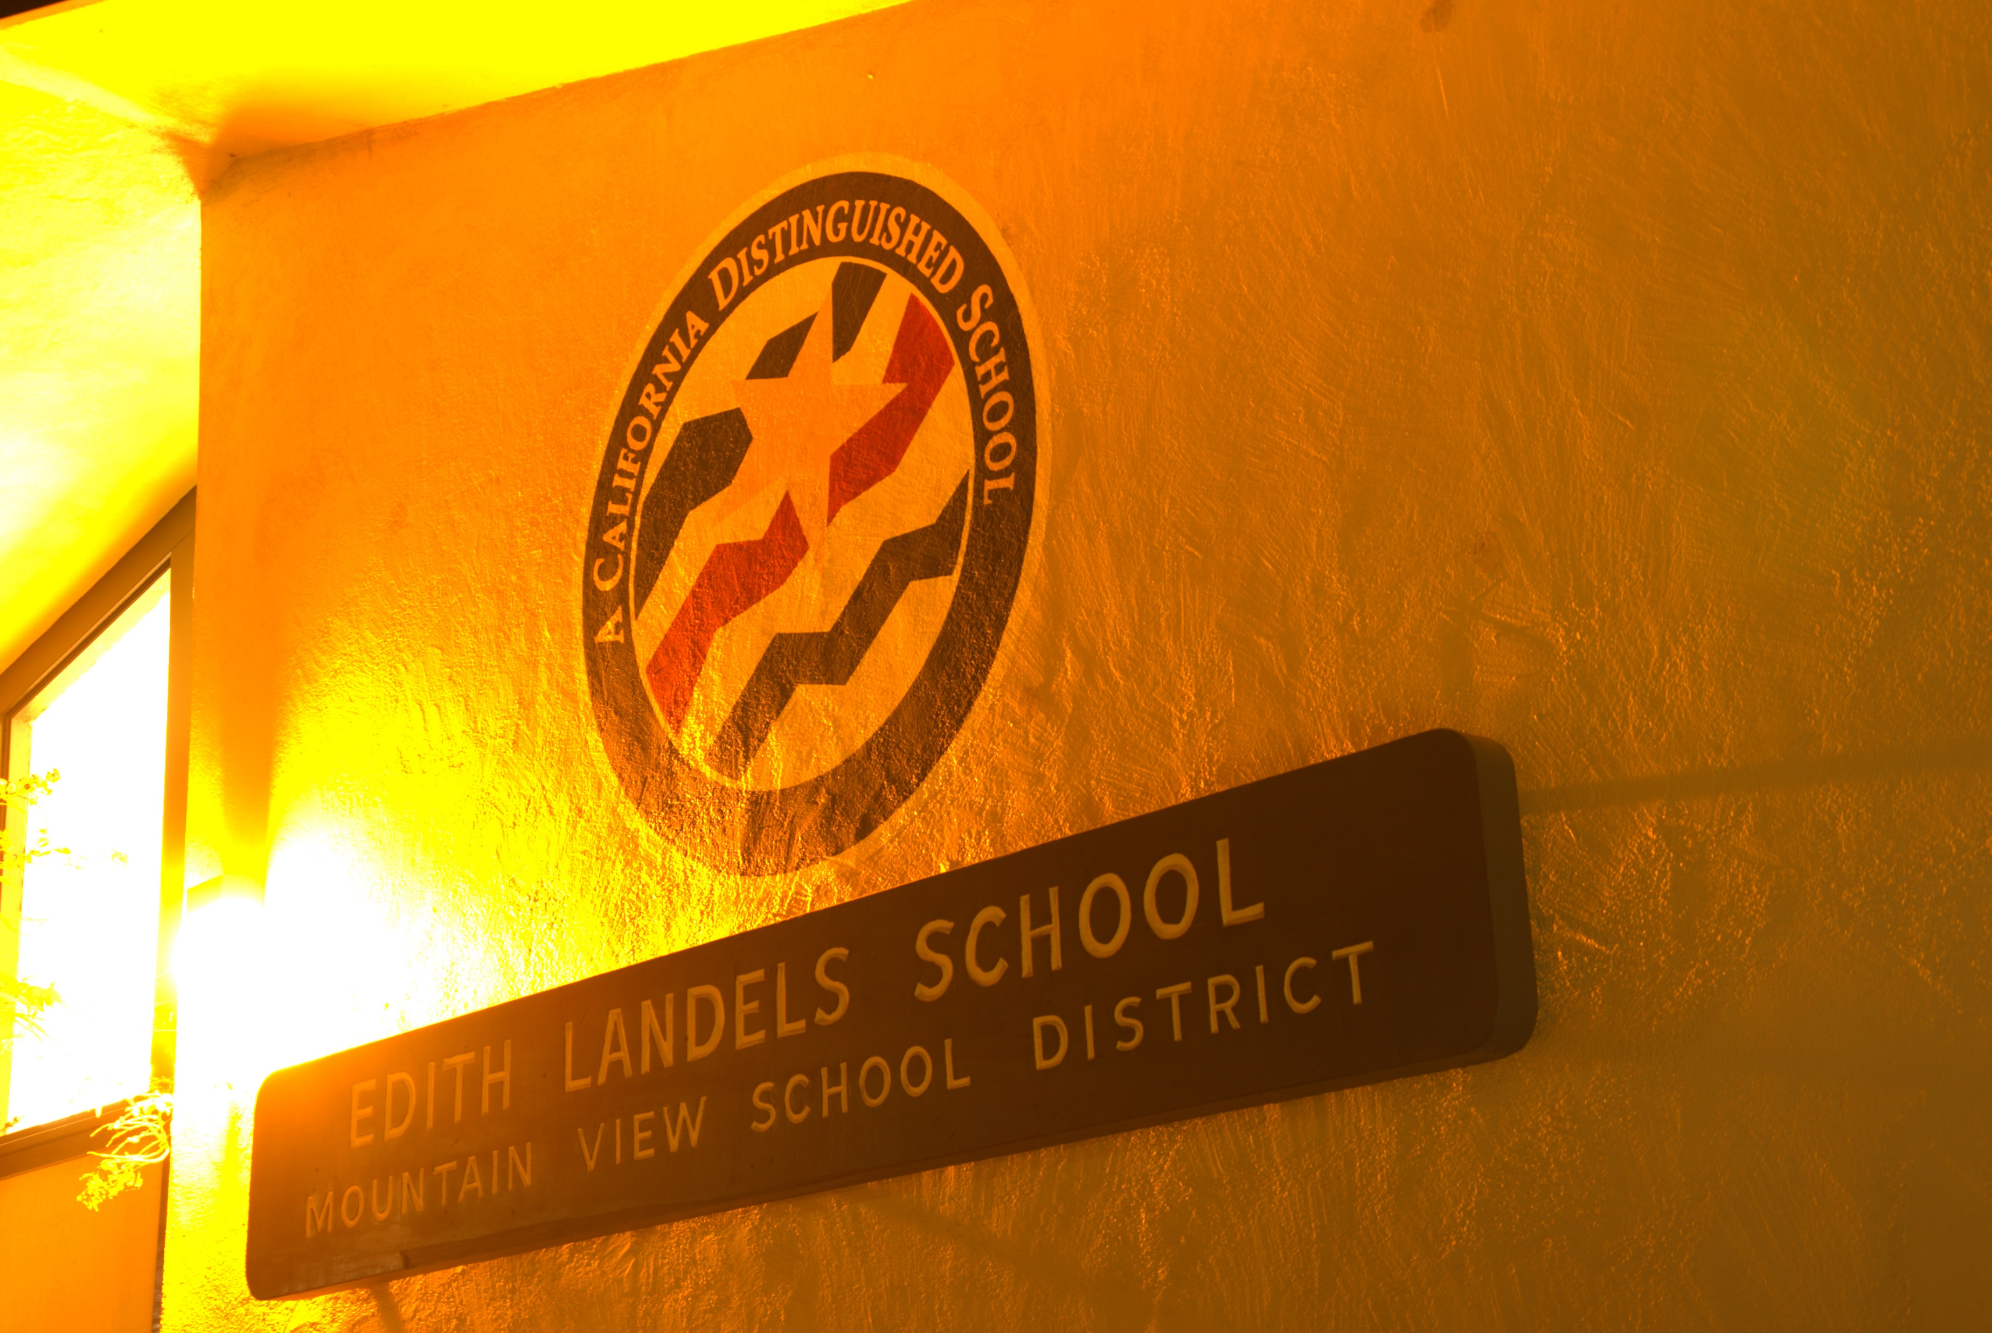
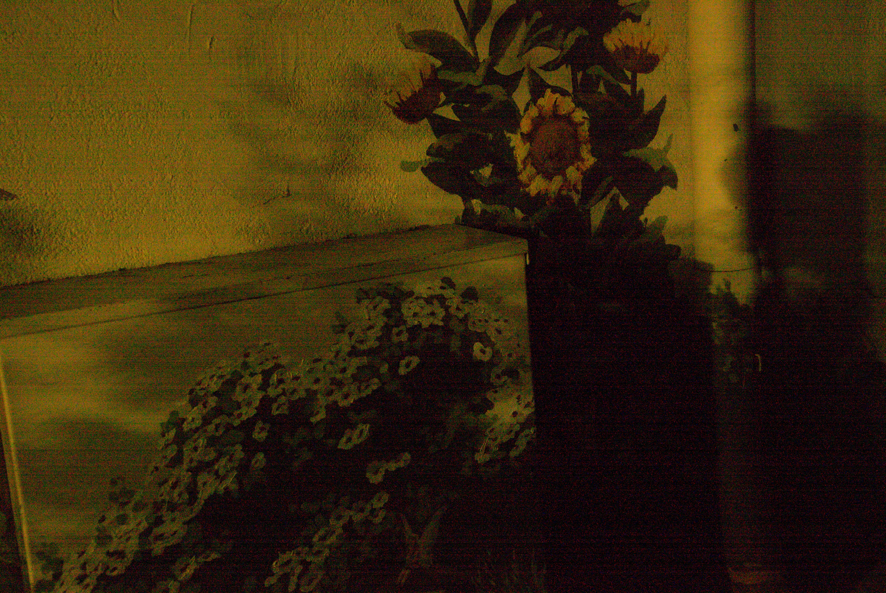
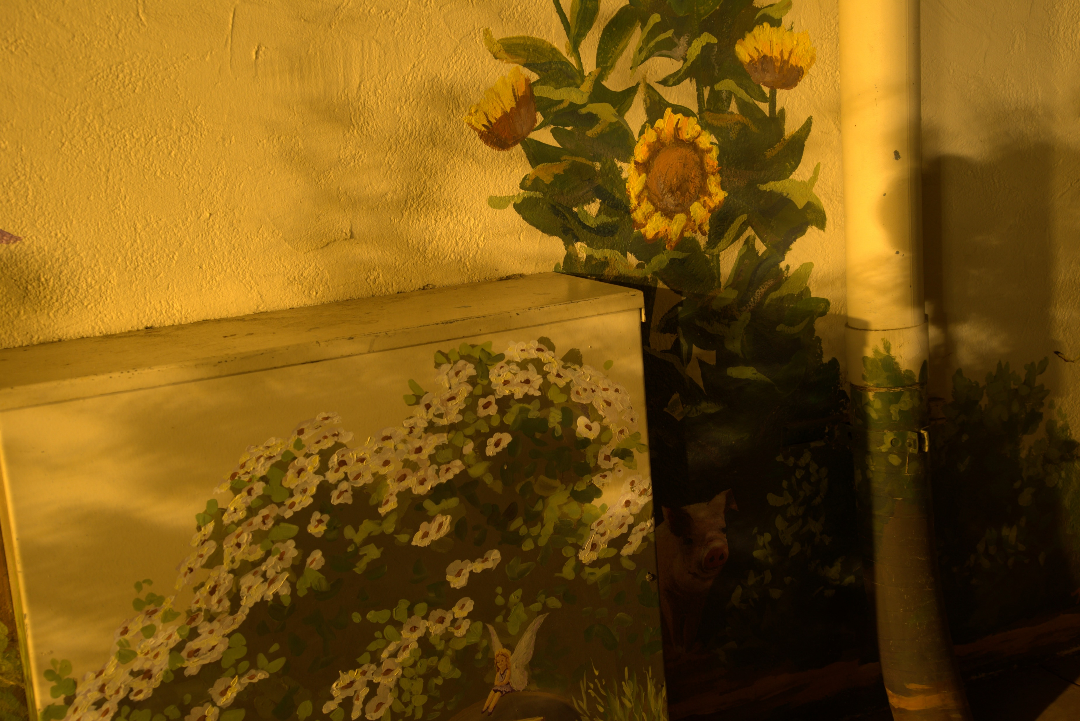
Finding the right dataset
See-in-the-Dark (SITD) Dataset
RAW images from 2 cameras: Fujifilm and Sony
5094 dark-bright pairs of images
Dark images at 1/10s – 1/30s exposure
Bright at 10s – 30s exposure (~100x higher)
Illumination for dark images: 0.03 lux indoors, 0.2 lux outdoors
Keep in mind: RAW images converted to JPG for display, has its own rebalancing algorithm

Slide 8
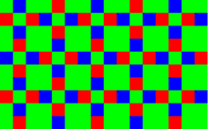
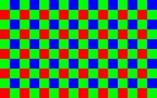
Problem of 4-channel images
RAW image formats are 4-channel
Filter arrays
Possible solutions
Variants in SITD dataset use different filter arrays
Fujifilm – X-Trans sensor
Sony – Bayer sensor
Cannot train on entire dataset
Cannot use JPEGs
Train 4-channel model – cannot be used for common JPG/PNG images
Convert to 3-channel images – risk loss of color accuracy
Full convolutions – risk losing model explainability
X-Trans filter
Bayer filter
8

Slide 9
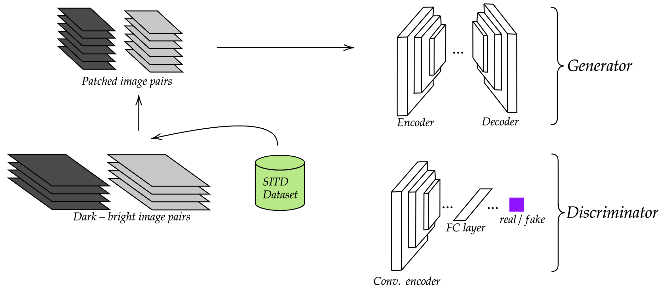
Implementation

Slide 10
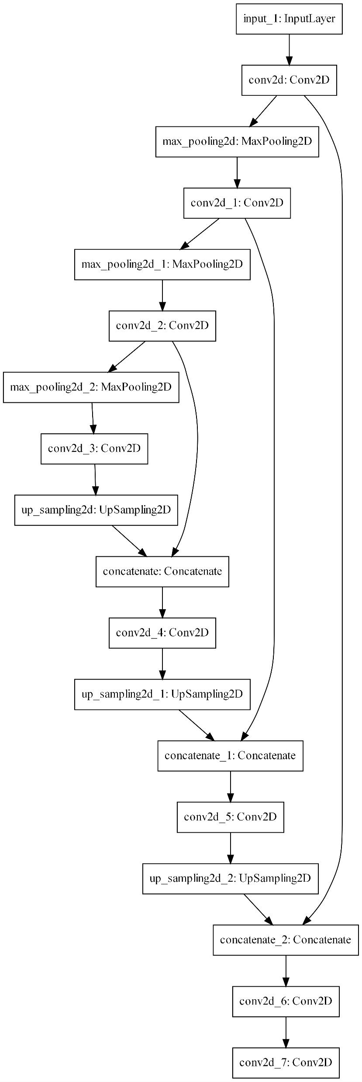
Fully convolutional networks
Use convolutional filters only – no fully connected layers
Can retain image shape from input to output
Can perform image-to-image training
Can apply convolutions throughout the network for various layer designs
Residual connections
Inception-like modules

Slide 11
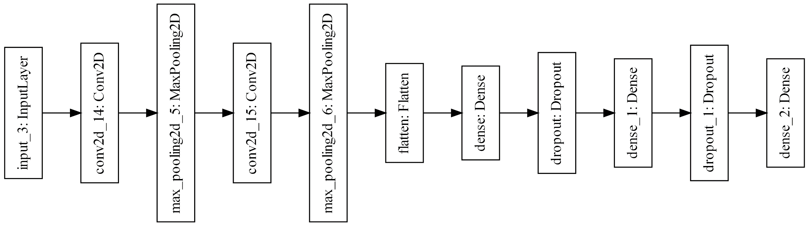
Simple GAN-based training
U-Net based generator
Basic CNN classifier as discriminator
Encoder-decoder architecture with 2 modifications for conv filters
Max-pooling for encoder, un-pooling for decoder
Skip connections before-max-pooling to after-un-pooling
2 conv blocks, 2 fully connected blocks
Conv blocks with max-pooling
FC blocks with dropout

Slide 12
Problem of training on large images
Huge training load
Solution: Patching
Images at ~1400x2100 leads to FCNs with >3M parameters – significantly more difficult to train
Loading large model and large images together
Convert large images into small patches for training
Merge patches after output
Caveat: unwanted noise at borders

Slide 13
Final model pipeline
Dataset preparation
Model design
Sony captures selected – smaller data size, easier conversion to JPG
Each bright image has up to 10 dark counterparts – darkest selected
Overlapping patches of size 100x100 with stride 50x50 for removing border noise
2-step training for simple GAN design as discussed
Generator loss minimizes difference b/w real and fake (generated) bright image
Discriminator loss used to maximize ability to separate real and fake

Slide 14
Final model pipeline

Slide 15
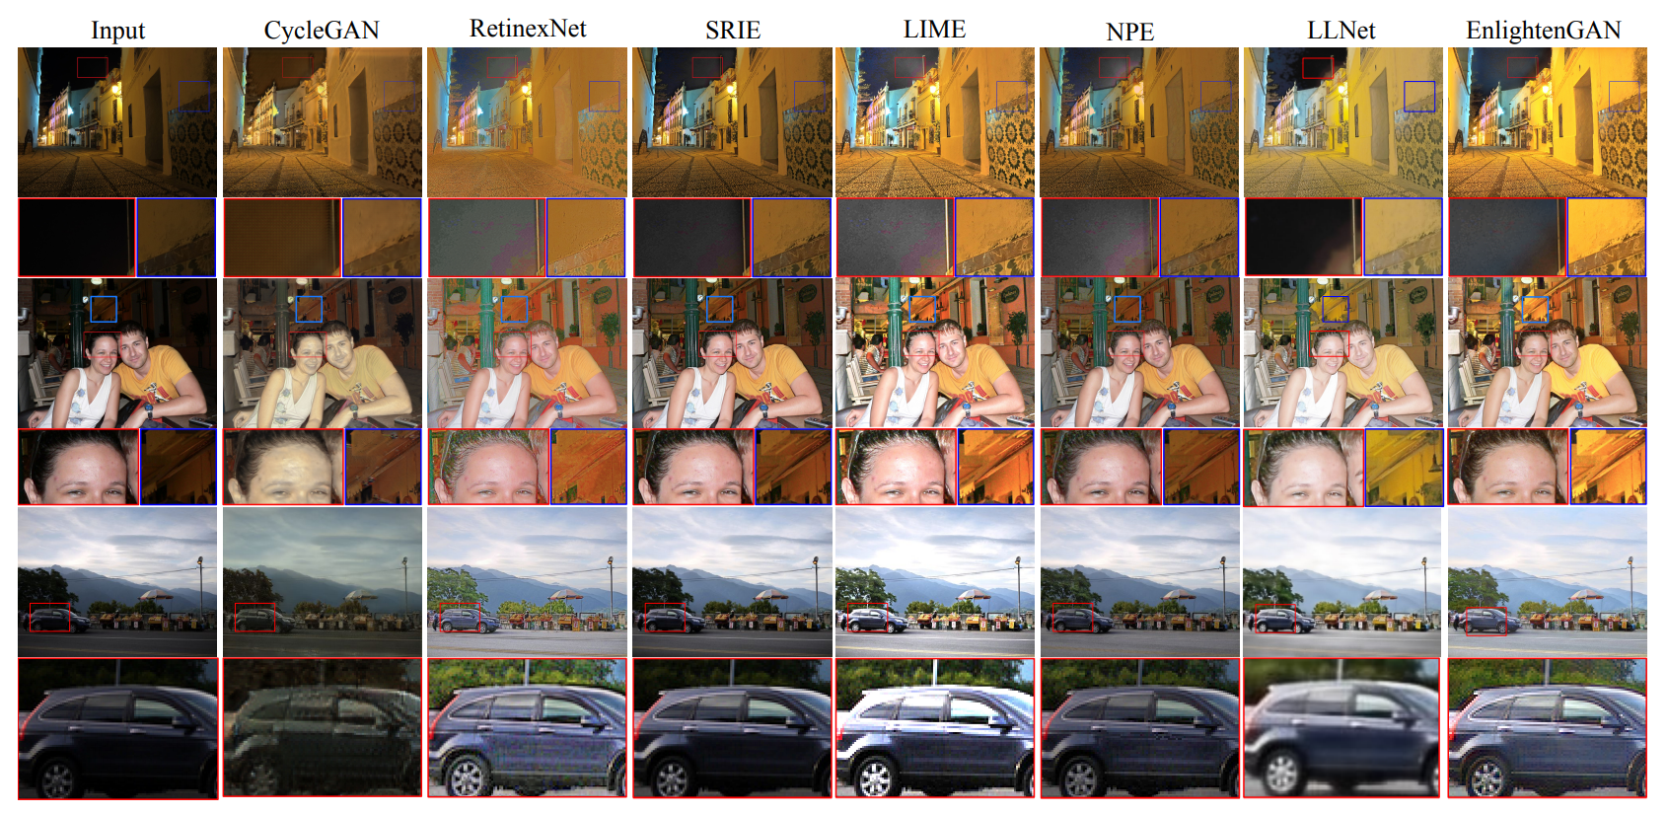
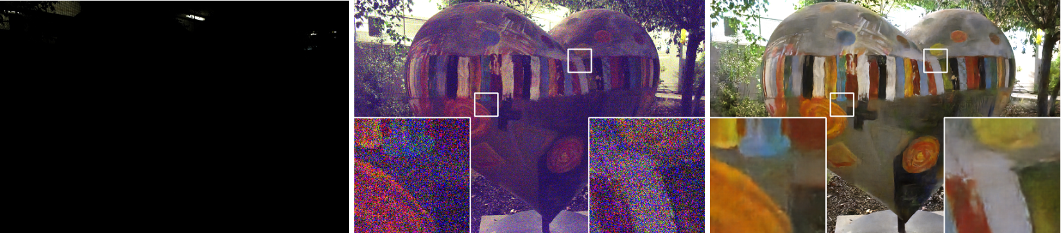
Results

Slide 16
Qualitative evaluation
Compared to traditional pipeline
Compared to other ML techniques
Upscaling + BM3D denoising
Variations across creative platforms like Photoshop, Affinity, GIMP, …
Upscaling messes with color balance, while denoising messes with sharpness
More realistic light balance
Better understanding of reflections and light sources
Color retention close to real-life even with “pitch-black” images

Slide 17
Conclusion & Future Work
Non-trivial problem
Image illumination especially useful for mobile photography
Simplified training procedure
Supervised learning means basic model designs and variations can be used
Final experiments remaining
Comprehensive quantitative evaluation
3-channel image dataset
Having original 3-channel database can help in better color accuracy with
TFLite backend open mobile deployment
Converting basic Keras or TF models to TFLite can help in designing apps with natively deployed image illumination models
Real-time processing
Current model is at ~50ms processing time, too high for 30fps (~30ms) for low-light video

Slide 18
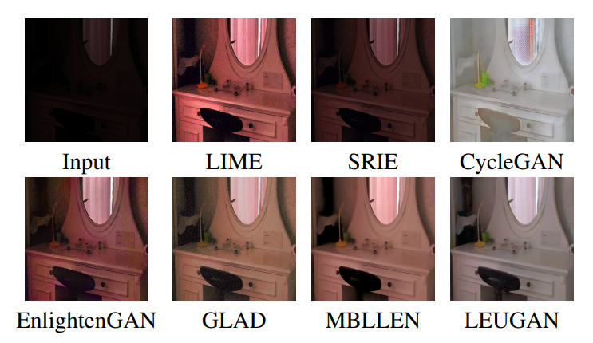
Thank You!
Chen, Chen, et al. "Learning to see in the dark." Proceedings of the IEEE Conference on Computer Vision and Pattern Recognition. 2018.
Jiang, Yifan et al. “EnlightenGAN: Deep Light Enhancement Without Paired Supervision.” IEEE Transactions on Image Processing 30 (2021): 2340-2349.
Qu, Yangyang, and Yongsheng Ou. "LEUGAN: Low-Light Image Enhancement by Unsupervised Generative Attentional Networks." arXiv preprint arXiv:2012.13322 (2020).
Some images gathered from public domain

